Slide 1
Journal Publishing in China:
Experience, Lesson, and Prospect
Charley MIAO
TrendMD, China
Board of ASCE

Slide 2
Main Contents
1. Evolution
2. Dynamics
3. Experience
4. Lesson
5. Prospects

Slide 3
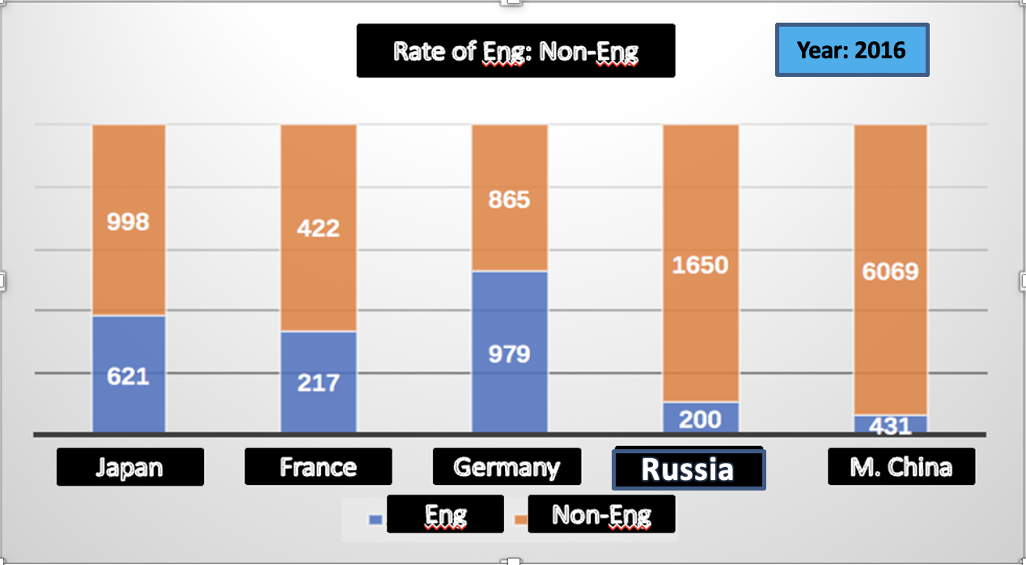
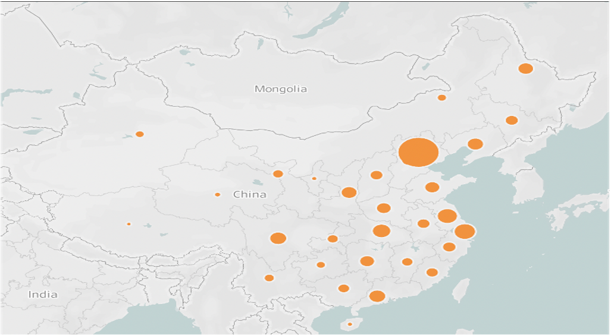
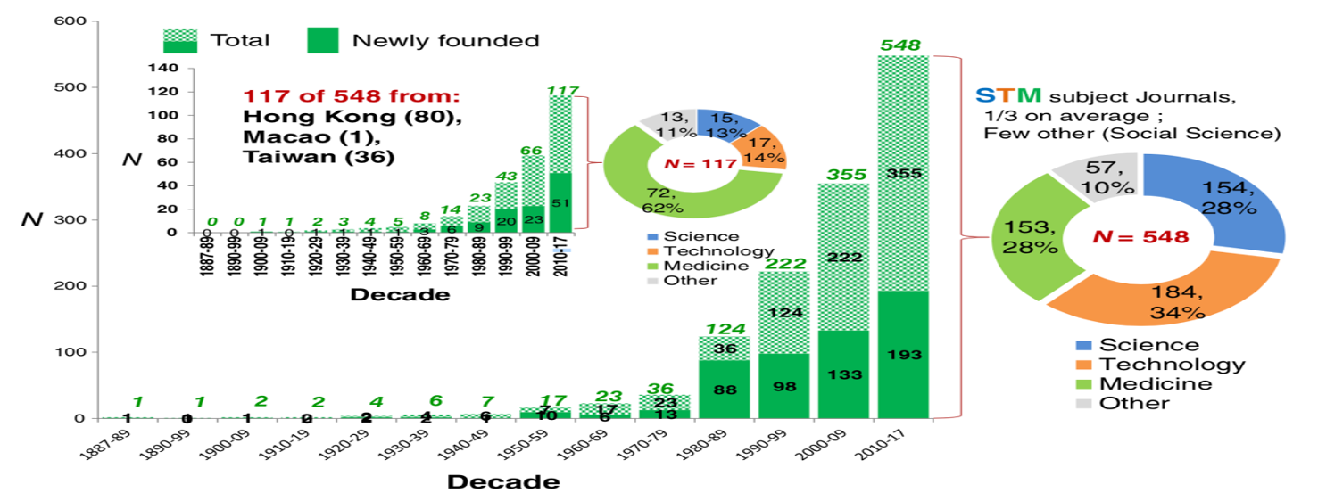
Imbalance of Scholarly Journals in Mainland China: Language, Region and Discipline

Slide 4
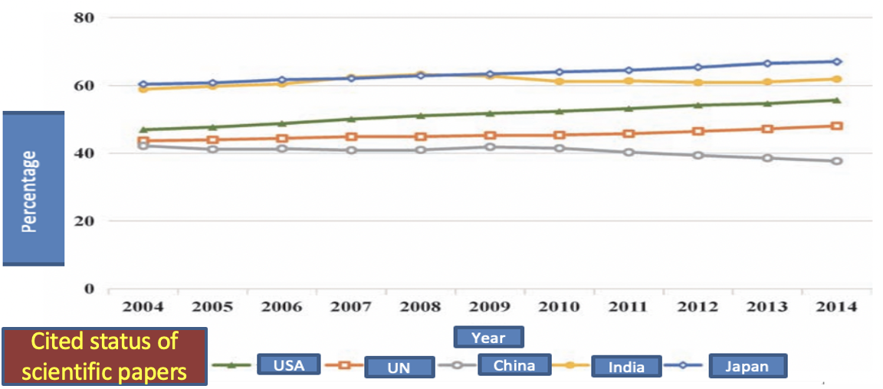
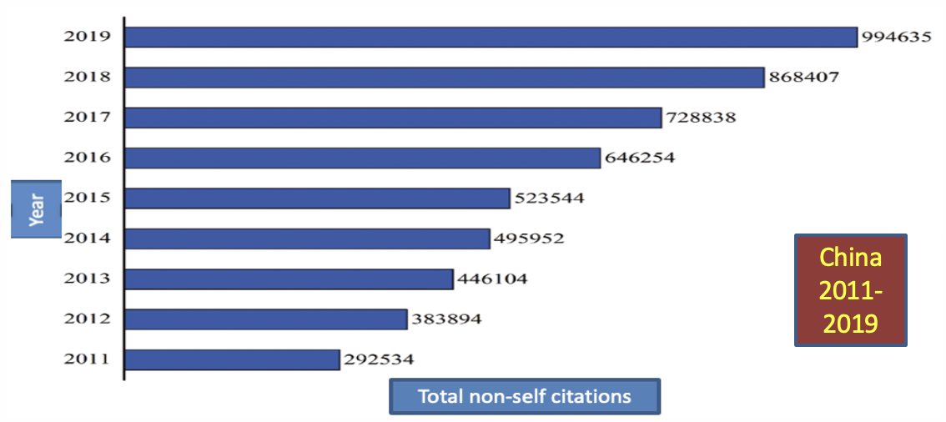
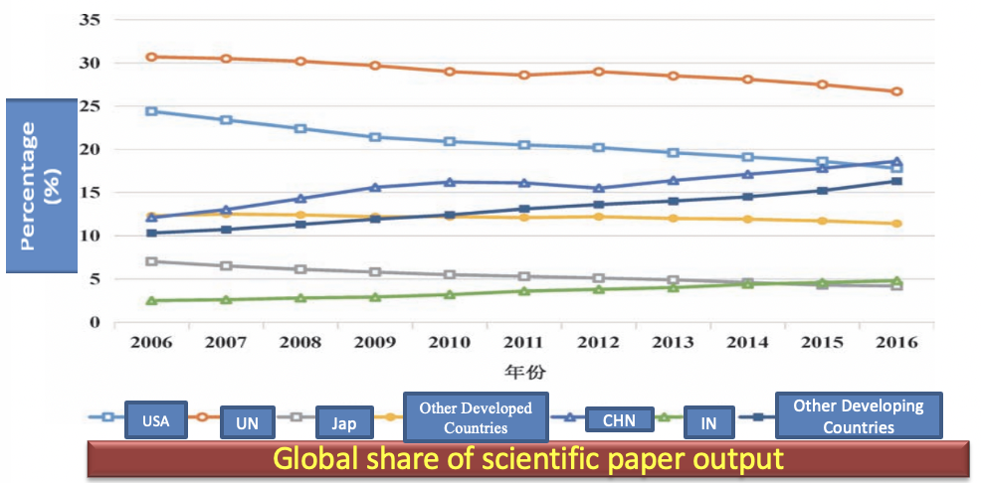
Publishing Trends of Academic Articles

Slide 5
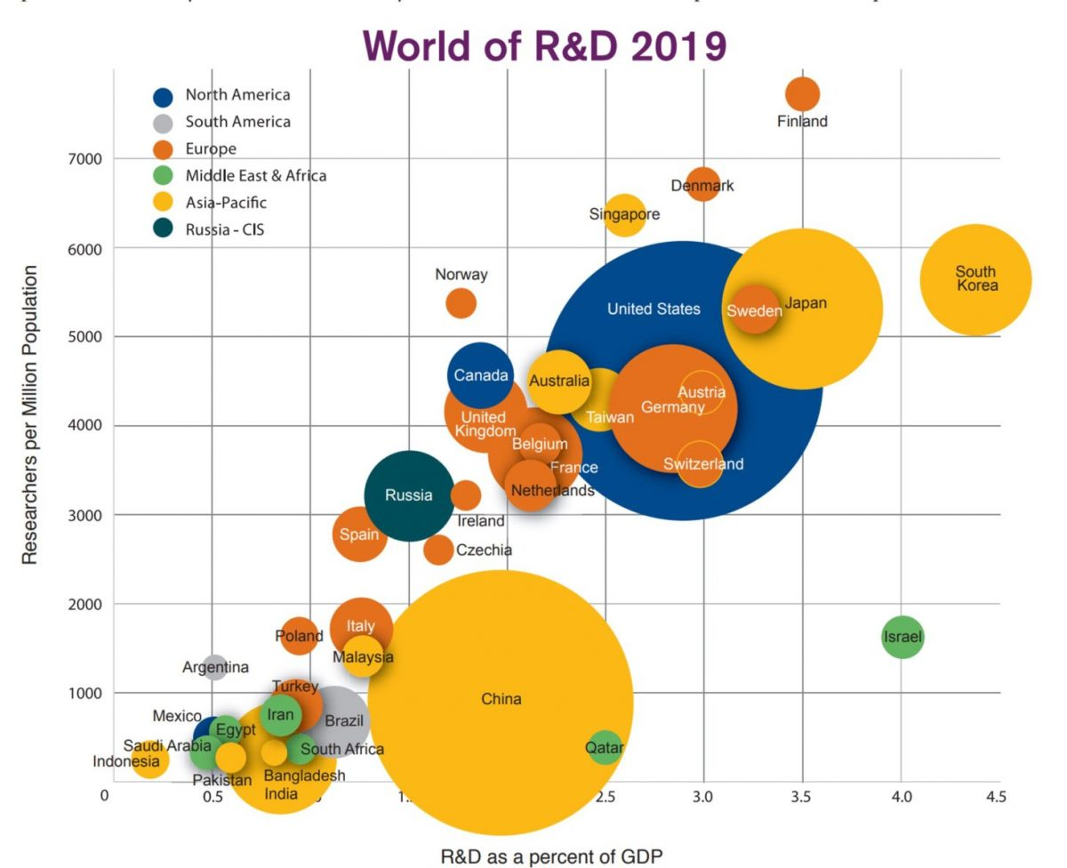
Policy Incentives: R&D expenditure increase

Slide 6
Dynamics for Scholarly Journal Publishing in M. China
Constructing world top ranking universities
International academic ranking: QS, U.S.News, THE, ARWU
Civil academic ranking: 211 project, 985 project, and most recently “Double First-Class” Initiative
Individual Promotion
Faster promotion
Better academic reputation
More students fans
China’s Rise
The world turning eyes to China
More academic confidence
Policy Incentives
R&D expenditure increase
Government and university incentives to publish in internationally renowned journals and local journals
Heavily founding for supporting journal development: Excellence Program recent 5 years and will be continued

Slide 7
Major Marketing Tools of Academic Articles

Slide 8
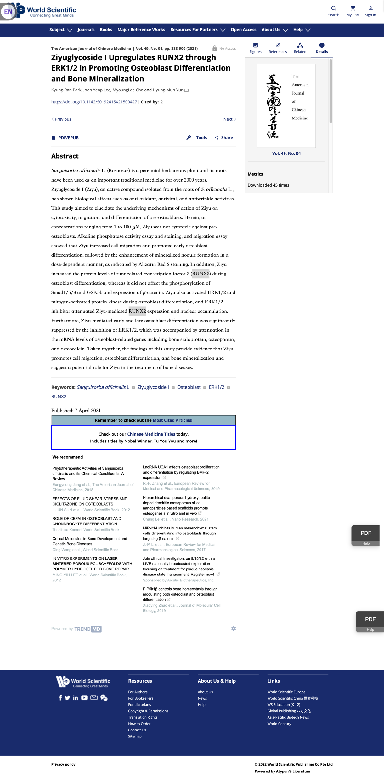
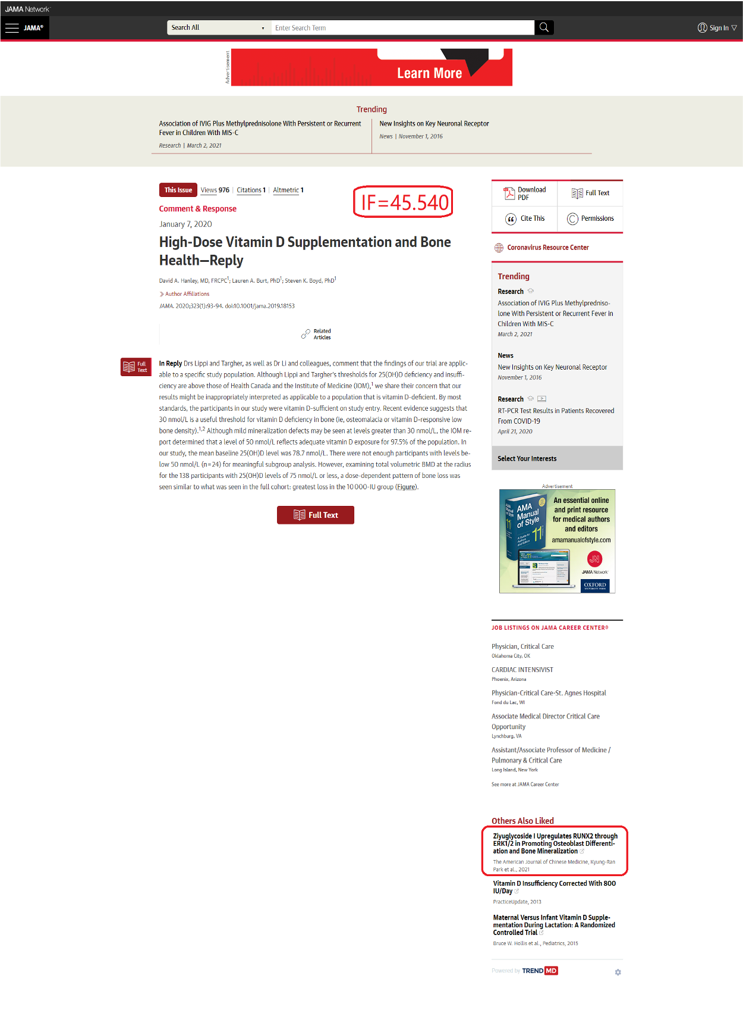
TrendMD Service: Free Widget Installations

Slide 9
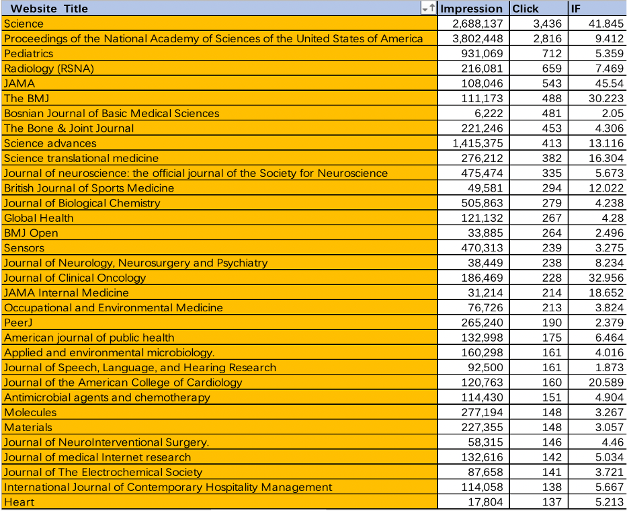
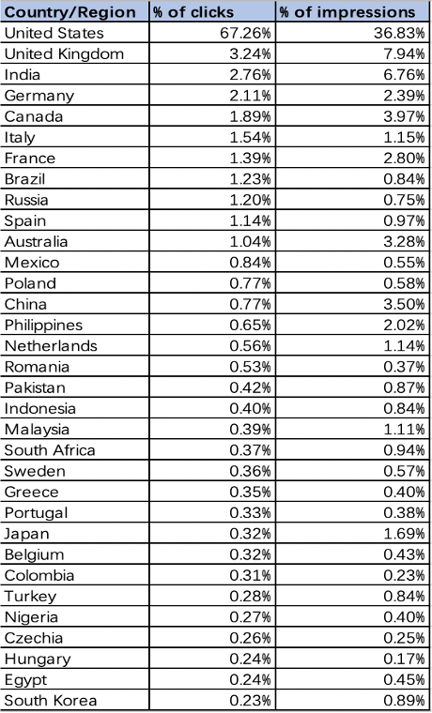
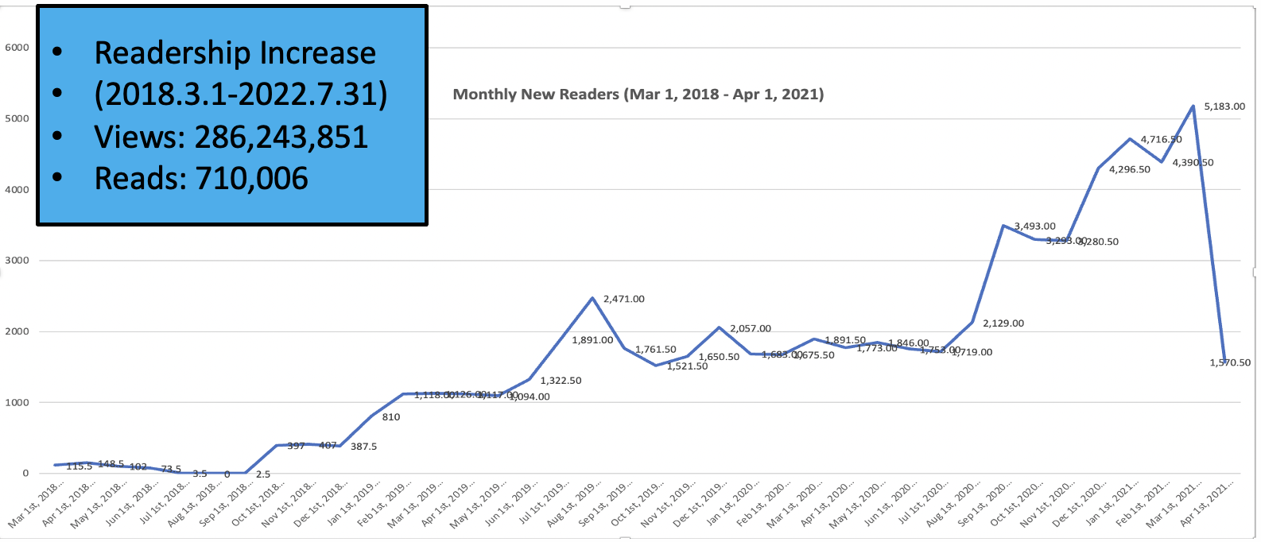
Case Study: World Scientific

Slide 10
Connected with International Top and Well-known Journals and Books

Slide 11
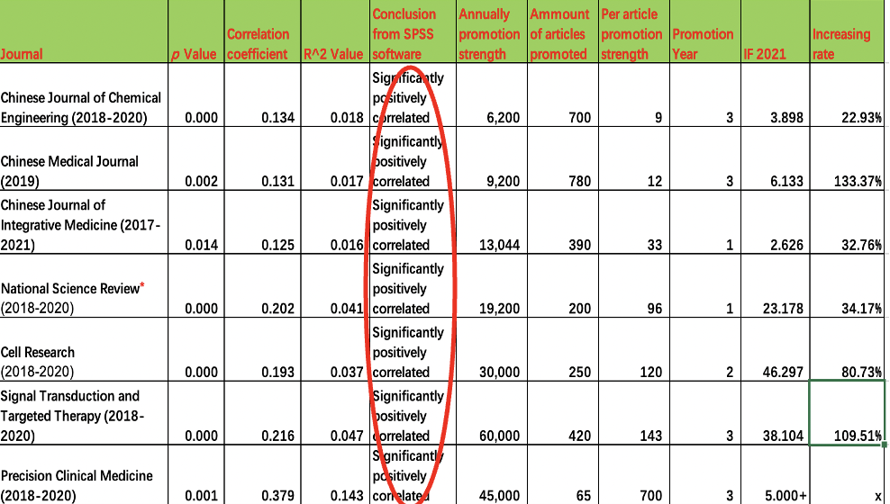
TrendMD Service Helps Drive Readership, Citations and IF’s

Slide 12
International Development Strategy for Academic Journals in M. China
Positioning Internationalization:
Based in China, Facing the World
Internationalization of Content:
Research must focus on world topics; content must attract world attention
Internationalization of Publishing:
Global manuscript grouping, international editorial norms, international cooperative publishing
Internationalization of Dissemination:
Diversified forms, accessible languages, diversified channels, and wider users

Slide 13
Charley MIAO Mobile：0086-15210155154 Email: charley.miao@trendmd.com WeChat：CharleyMiao

